Slide 1

Autonomous Cyber-Physical Systems: Course Introduction
Fall 2024: CS 513
Instructor: Jyo Deshmukh
Course website: https://shorturl.at/lv9zO
Course materials: https://shorturl.at/zwSHe

Slide 2
What is a Cyber-Physical System?
Different ways to answer this question!
Wikipedia: A Cyber-Physical system (CPS) is a mechanism controlled or monitored by software algorithms.
NSF: engineered systems built from, and depending upon, the seamless integration of algorithms and physical components
From a historical perspective CPS combines elements of cybernetics, mechatronics, control theory, process science, embedded systems, distributed control, and more recently communication.
One common saying: CPS = Control + Computation + Communication

Slide 3
Our focus on CPS in this course
Control
Systems where the behavior of the physical components is strongly influenced by the software components
Systems where there the communication between the physical component and the software component may be direct or through a network
Systems in which the primary role played by software is control (in contrast to passive monitoring)
Communi-cation
Computation
CPS

Slide 4
One view of a CPS
Actuators
Physical component
Sensors
Environment/Plant
Communication Network
Controller
(Some embedded code)

Slide 5
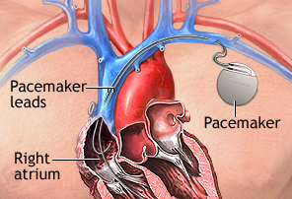
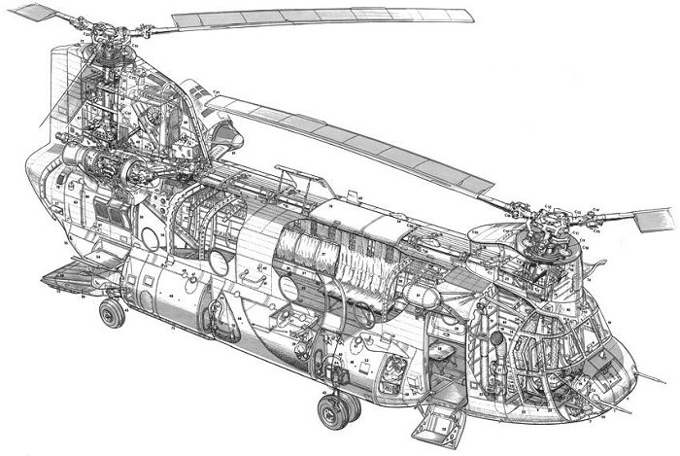
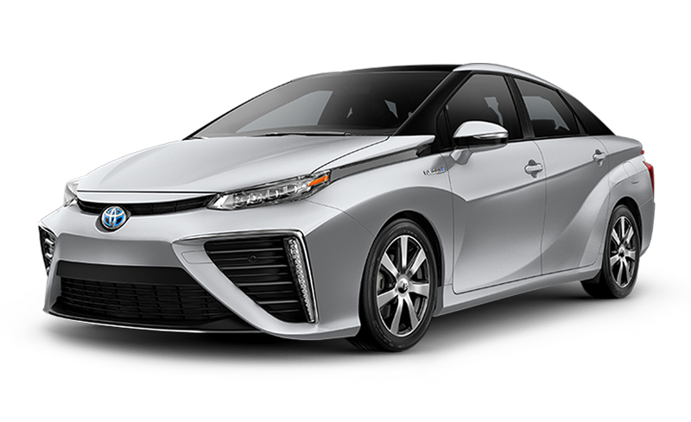
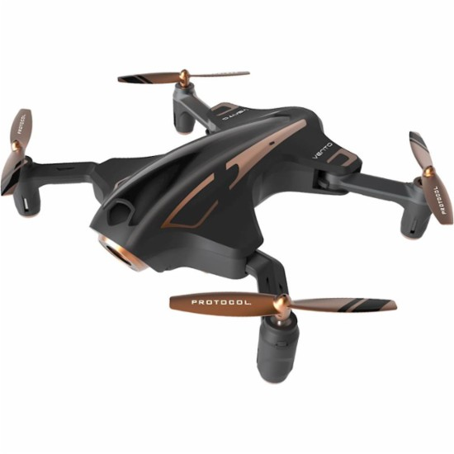
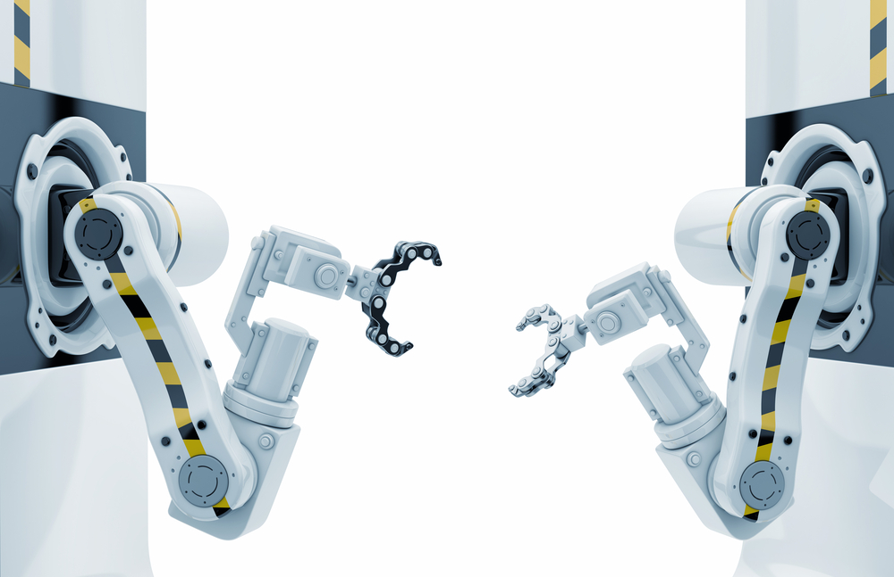
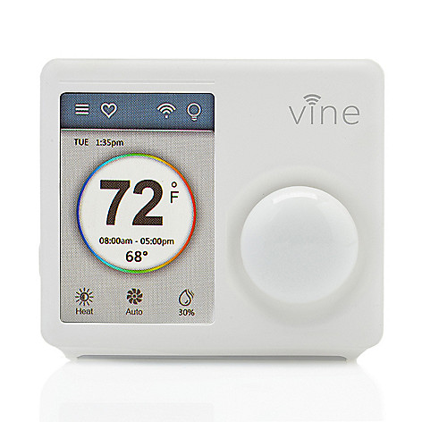
Examples
[All images from Google image search]

Slide 6
What’s an autonomous CPS?
Autonomous: without the need for human intervention or control
Autonomous CPS = CPS with no human operator!
Semi-autonomous: CPS with autonomy under specific conditions but requiring a human operator otherwise.
Today, several CPS examples are semi-autonomous, and getting to fully autonomous

Slide 7
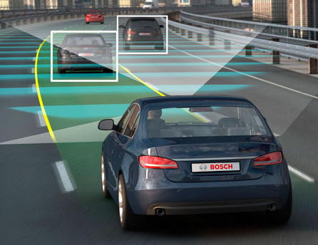
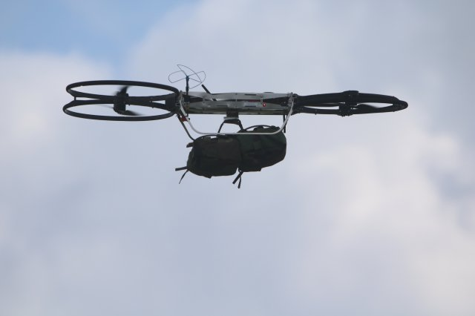
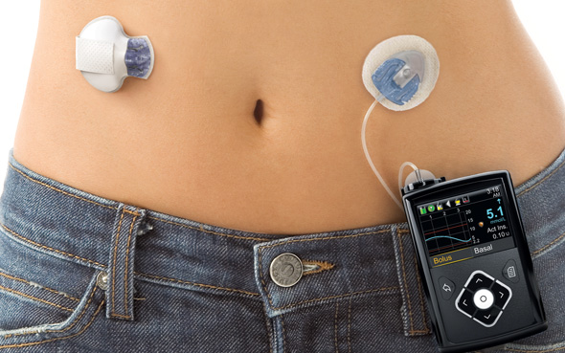
Autonomous/Semi-autonomous CPS
Image credit: Motor Authority
Image credit: army.mil
Image credit: Google images

Slide 8
Course Objectives
Gain basic familiarity with CPS topics
Computational models
Control algorithms
Ingredients for autonomy
Challenge Problems/Case studies
Model-Based Software Development Paradigm for CPS
Developing models for physical components + software + communication
Software Engineering: Writing checkable requirements and tests
Software testing for CPS
Learn autonomous software stack through case studies in autonomy

Slide 9
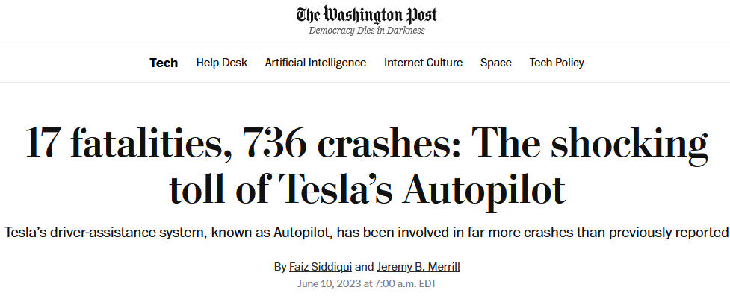
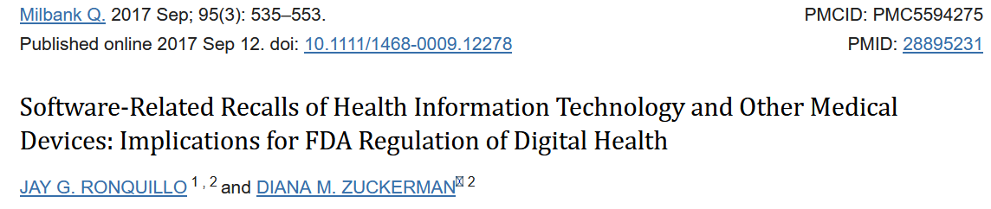
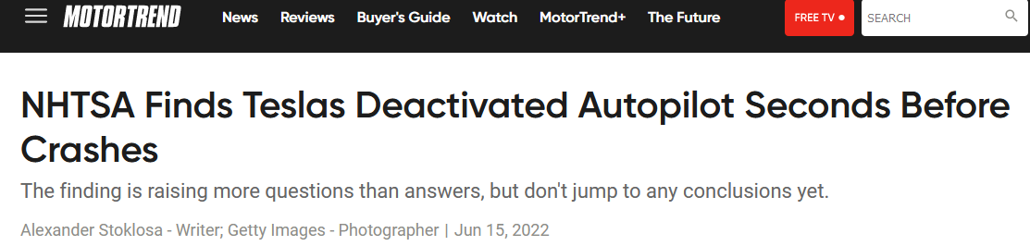
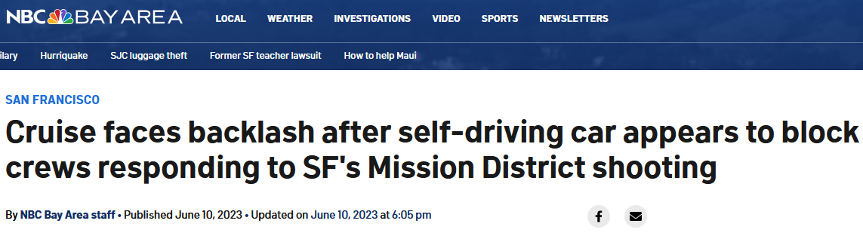
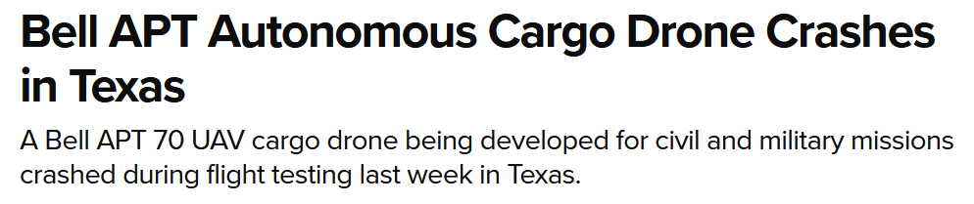
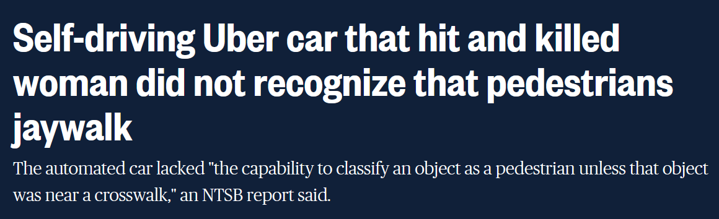
Key theme of the course: Safe Autonomy
ACPS are safety-critical, and/or mission-critical with huge implications on human health, well-being, economy, etc.

Slide 10
Course Overview
Part I: Models of Computation, Model-based Control Design
Synchronous & Asynchronous Models, Timed Models, Dynamical System Models, Hybrid Models, Basics of Control
Part II: Safety: Specifications, Monitoring, Test Generation, Verification
Temporal Logic, Test Generation, Falsification
Part III: Ingredients of Autonomy
Basics of modern perception, planning, decision-making, reinforcement learning

Slide 11
How will we evaluate ourselves?
4 Written Homework Assignments
Focus on theory
2 Mini-Projects
Learn how to code the controller for a self-driving car subsystem
Learn how to use a vision-based perception module as a sensor
Class Project

Slide 12

Class Project
Details at: https://shorturl.at/3uOUd
Purpose:
Freedom to choose your own advanced application
Write formal requirements
Generate tests/proofs using verification/falsification/test generation
Show the application of formal reasoning
Expected outcome:
Model the environment/deployment scenario for an ACPS application
Design the autonomous software stack for an ACPS
Demonstrate that it works
Show a test/verification/assurance strategy

Slide 13
Example Projects (do not have to pick any of these)
Design an eVTOL to follow a specific route plan (specified formally)
Vehicle model and controller to automatically change lanes
Explore multi-vehicle simulators for collaborative merging, autonomous intersection control
Traffic simulator for vehicle platooning
Create a model of the human heart and design a pacemaker
More ideas on the Project Resources page!

Slide 14
Project Timeline
Project teams
Minimum team size : 4, Maximum : 5
Team size proportional to expectation on outcome
Use Piazza for forming teams
Identify team members & an initial proposal by Sep 30
Proposal format on the web-page
Project check-in: November 11
Project presentations on 12/2
Final Project Deliverable
15-page project report

Slide 15
Grading and Evaluation Breakdown
Assignments: 40% (10x4)
Mini-Projects: 30% (15x2)
Project: 35%
Proposal: ungraded
Final Report: 5% (talk) , 20% (final report or demo)
Class participation: 5%
Q&A, Project engagement, Office hours, …

Slide 16
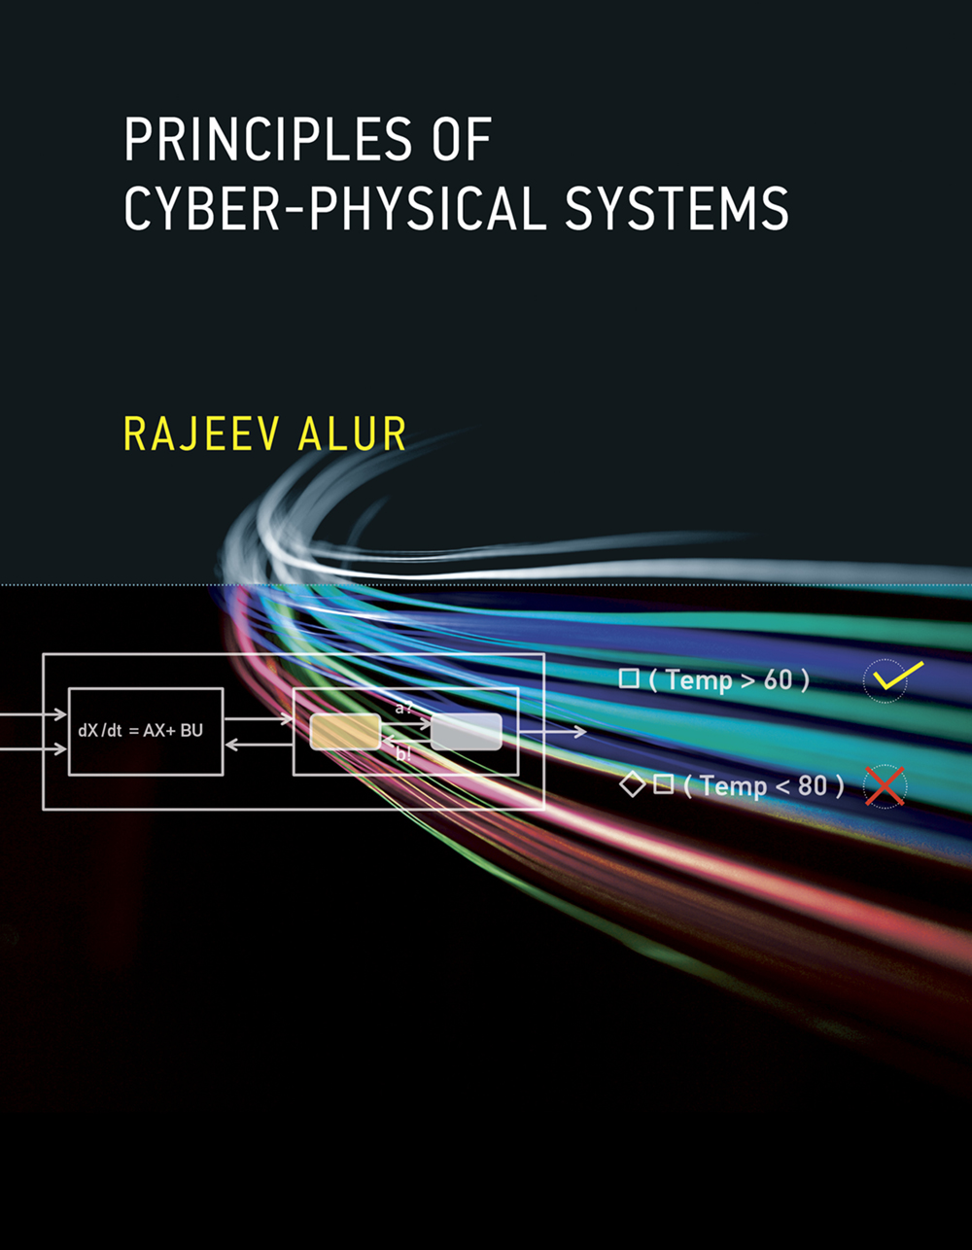
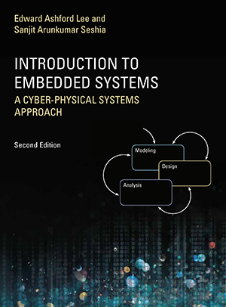
Textbooks: None. Supplementary reading:
Principles of Cyber-Physical Systems by Rajeev Alur
$56-63 on Amazon
Free e-book available on USC libraries
Introduction to Embedded Systems: A CPS approach
- Free at: https://ptolemy.berkeley.edu/books/leeseshia/

Slide 17
Office Hours, Class Timings
Class Timing: 2:00-5:20
First 5 mins: recap of last lecture + outline of this lecture + announcements
Last 20 mins: optional questions, discussions, etc.
Office Hours: Monday, 11:00am-12:00pm (or by appointment)
TAs: Sheryl Paul, Vidisha Kudalkar, Jeremy Morgan
Office Hours: TBD

Slide 18
Logistics
Piazza:
This term we will be using Piazza for class discussion. The system is highly catered to getting you help fast and efficiently from classmates, the TAs, and myself. Rather than emailing questions to the teaching staff, post your questions on Piazza. Find our class page at: https://piazza.com/usc/fall2024/csci513/info

Slide 19
Questions?

